Slide 1


Learning finite state machine models of evolving systems: From evolution over time to variability in space
Carlos Diego Nascimento Damasceno
Advisors: Adenilso Simão (University of Sao Paulo) & Mohammad Mousavi (University of Leicester)
Notes:
Good morning everyone, thanks for joining the defense of my PhD Thesis entitled “Learning finite state machine models of evolving systems”. In this presentation, I show the result of my four-years PhD project under the supervision of Adenilso Simao from the University of Sao Paulo and Mohammad Mousavi from the University of Leicester.

Slide 2
Agenda
Introduction
Research Problem
Research Objectives
Learning to Reuse
Learning from Difference
Learning by Sampling
Final Remarks and Future Work
Notes:
First, I will introduce the context and the research problem addressed in my PhD. Next, I will detail the three research objectives of my Thesis, namely:
Learning to reuse,
Learning from difference, and
Learning by Sampling
Finally, I will conclude this presentation with the final remarks and a few future work that can be further investigated.

Slide 3


Introduction
Software maintenance [IEEE, 2006]
“... modifications after delivery to correct faults, to improve non-functional attributes ...”
Software evolution [Lehman, 1979]
“... programs must be modified because they operate in or address problems in the real world ...”
IEEE, ‘ISO/IEC/IEEE International Standard for Software Engineering - Software Life Cycle Processes - Maintenance’, ISO/IEC 14764:2006, pp. 1–58, Sep. 2006
M. M. Lehman, ‘On understanding laws, evolution, and conservation in the large-program life cycle’, Journal of Systems and Software, vol. 1, pp. 213–221, 1979
Notes:
Essentially, my PhD project is motivated in two software engineering principles:
Maintenance, that is the process of implementing …
Evolution, which states that…

Slide 4








Introduction
Configuration m
…
…
…
Variability in space
Configuration 2
…
Configuration 1
Version 1
Version 2
Version 3
Version n
Evolution over time
K. Pohl, G. Böckle, and F. J. van der Linden, Software Product Line Engineering: Foundations, Principles and Techniques. Secaucus, NJ, USA: Springer-Verlag New York, Inc., 2005.
H. Chockler, D. Kroening, L. Mariani, and N. Sharygina, Eds., Validation of Evolving Software. Cham: Springer International Publishing, 2015.
M. S. Deutsch, ‘Tutorial Series 7 Software Project Verification and Validation’, Computer, vol. 14, no. 4, pp. 54–70, Apr. 1981
Notes:
These principles aid changes in software projects
“over time”, in terms of new versions; and “in space”, if different configurations are needed to satisfy the requirements of different user profiles or software platforms. Additionally, they also require special attention as every modification opens opportunities for mistakes that may compromise software quality.

Slide 5
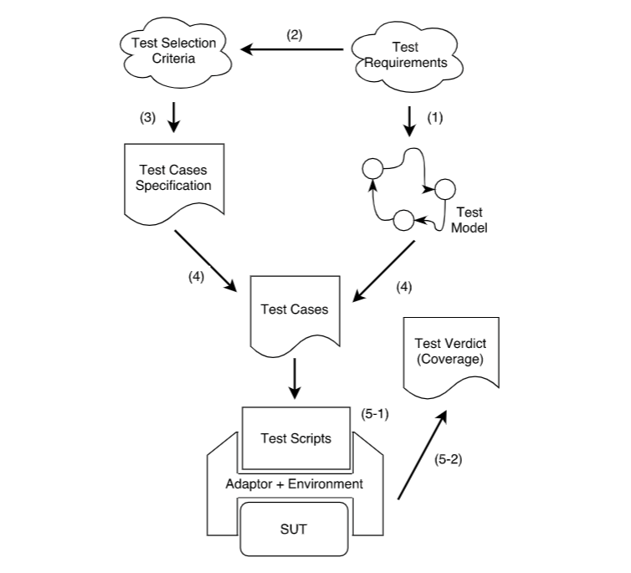

Introduction
…
V1.0
V2.0
V3.0
Vn
Evolution over time
Model-Based Testing (MBT)
M. Utting, A. Pretschner, and B. Legeard, ‘A taxonomy of model-based testing approaches’, Software Testing, Verification and Reliability, vol. 22, no. 5, pp. 297–312, 2012.
Notes:
To mitigate this risk, software testing techniques, such as model-based testing, can be employed to assess requirements that shall hold over time.

Slide 6

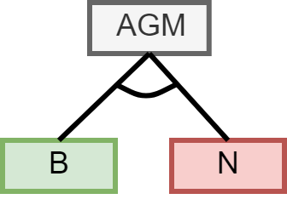

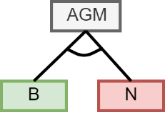
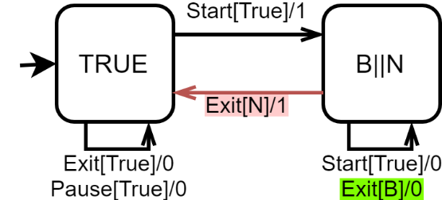
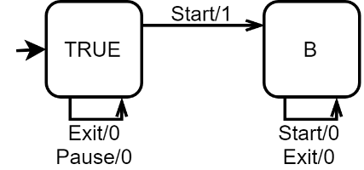

Introduction
Configurations
Features
Family model-based testing
Conf. 2
Conf. m
Model-Based Testing (MBT)
Variability in Space
T. Thüm, S. Apel, C. Kästner, I. Schaefer, and G. Saake, ‘A Classification and Survey of Analysis Strategies for Software Product Lines’, ACM Comput. Surv., vol. 47, no. 1, p. 6:1–6:45, Jun. 2014
V. Hafemann Fragal, A. Simao, and M. R. Mousavi, ‘Validated Test Models for Software Product Lines: Featured Finite State Machines’, in `FACS 2016.
S. Oster, ‘Feature Model-based Software Product Line Testing’, PhD Thesis, Technische Universität, Darmstadt, 2012.
Notes:
When a set of product-specific models is available, model-based testing can also be applied to systems incorporating variability in space, such as software product lines. However, product-based strategies can be inefficient due to the potentially exponential number of configurations and redundant computations. To cope with these issues, model-based testing strategies specifically tailored to extended modelling notations, such as family models, can incorporate knowledge about valid feature combinations to optimize SPL analysis. Empirical studies have shown that family model-based testing can outperform traditional product-based techniques in terms of effectiveness.

Slide 7
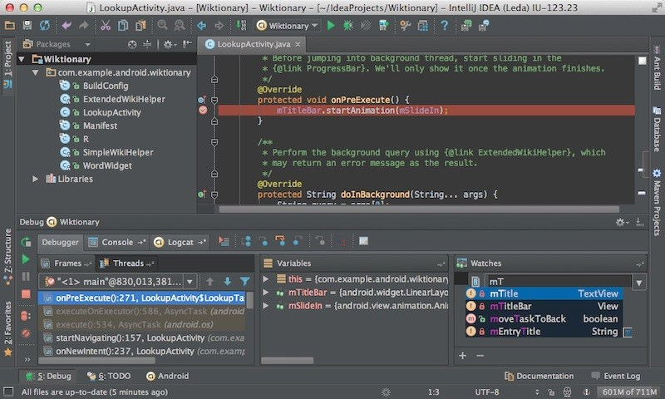
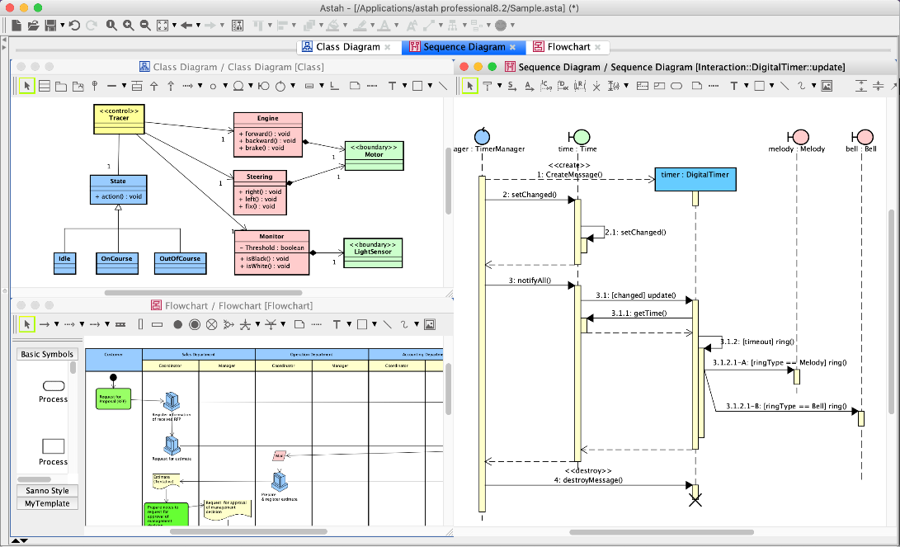



Introduction
Source code and models should be maintained and evolve together!
Notes:
These evidences show a few good reasons to invest on the joint maintenance and evolution of coding and modelling artefacts.
However, in reality, model maintenance is often neglected, projects may lack updated artifacts and hence, model-based reasoning may become actually an unreasonable approach.

Slide 8
Research Problem
How can we efficiently and effectively learn finite state machines specifying the behavior of an evolving system?
Notes:
Motivated by these problems, in my PhD Thesis, I proposed to investigate the following research problem:

Slide 9
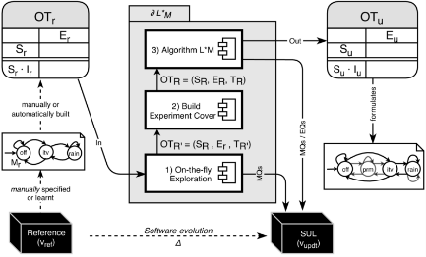
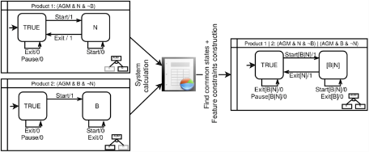
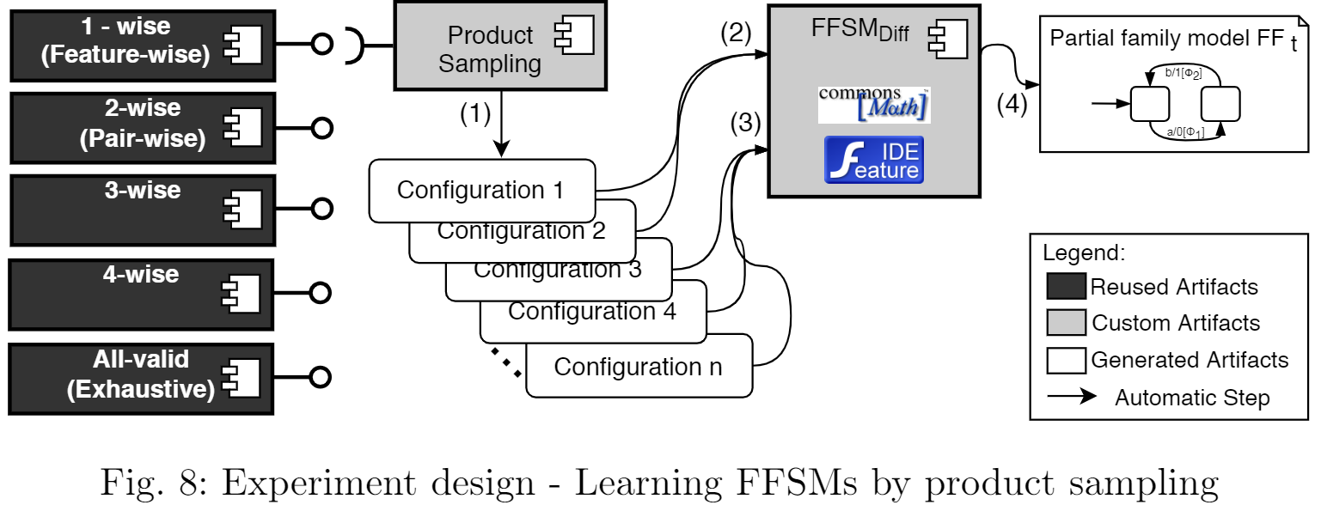
Research Objectives
Learning to Reuse
Learning from Differences
Learning by Sampling
Notes:
This PhD Thesis is organized in three research objectives namely, …, which I will discuss along this presentation.

Slide 10
Learning to Reuse
Adaptive Model Learning for Evolving Systems
Paper presented in the 15th Integrated Formal Methods, Bergen, Norway, 2019
Adaptive Model Learning for Evolving Systems

Slide 11


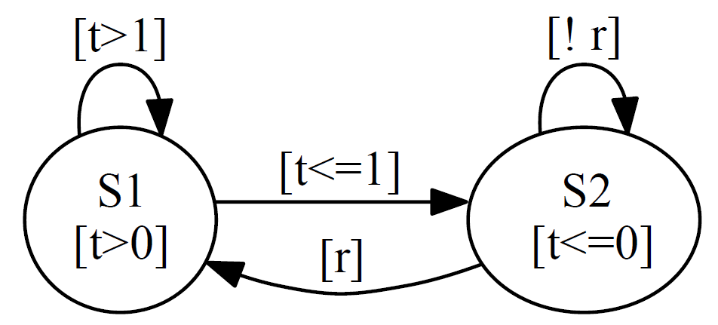
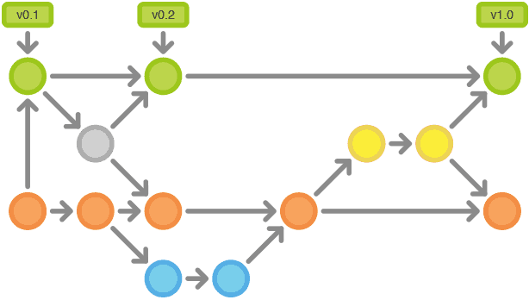
Context (Learning to Reuse)
Software analysis is a model-based activity
Models stuck to engineers’ minds
Formally denoted as explicit models
Software undergoes changes along the life-cycle
Evolution over-time (e.g., update, upgrade)
Models may become outdated
…
R. V. Binder, Testing Object-oriented Systems: Models, Patterns, and Tools. Boston, MA, USA: Addison-Wesley Longman Publishing Co., Inc., 1999.
N. Walkinshaw, ‘Chapter 1 - Reverse-Engineering Software Behavior’, in Advances in Computers, vol. 91, A. Memon, Ed. Elsevier, 2013, pp. 1–58.
Notes:
In this first objective, two facts should be noticed:

Slide 12
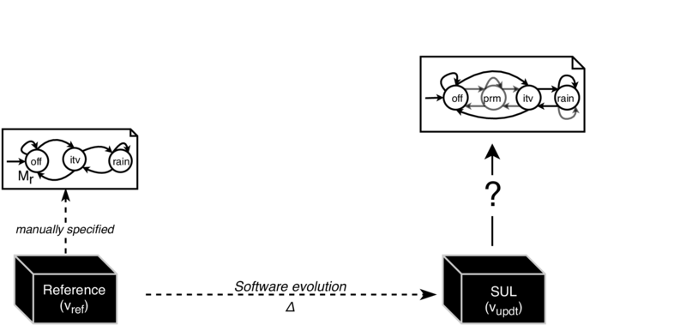

Research Problem (Learning to Reuse)
How can we efficiently construct behavioral models from evolving systems?

Slide 13
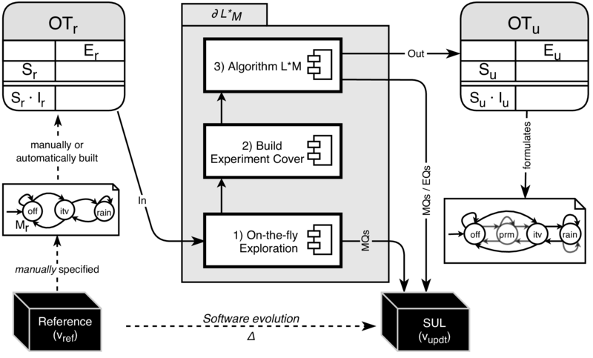
Contribution (Learning to Reuse)
An adaptive algorithm that is more efficient than the state-of-the-art for learning behavioral models from evolving systems

Slide 14
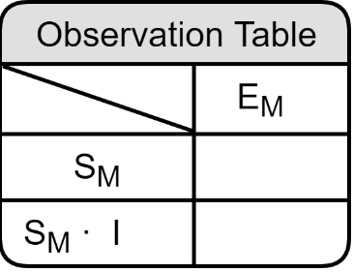


Model Learning
Minimally Adequate Teacher (MAT)
Separating Sequences
Model Learning Algorithm
Equivalence Queries (EQ)
Model-Based Testing (MBT)
Yes || Counterexample
Transfer Sequences
Output
Reset + Inputs
Formulate
Membership Queries (MQ)
Query Output
System Under Learning
(SUL)
D. Angluin, ‘Learning regular sets from queries and counterexamples’, Information and Computation, vol. 75, no. 2, pp. 87–106, 1987
F. Vaandrager, ‘Model Learning’, Commun. ACM, vol. 60, no. 2, pp. 86–95, Jan. 2017

Slide 15
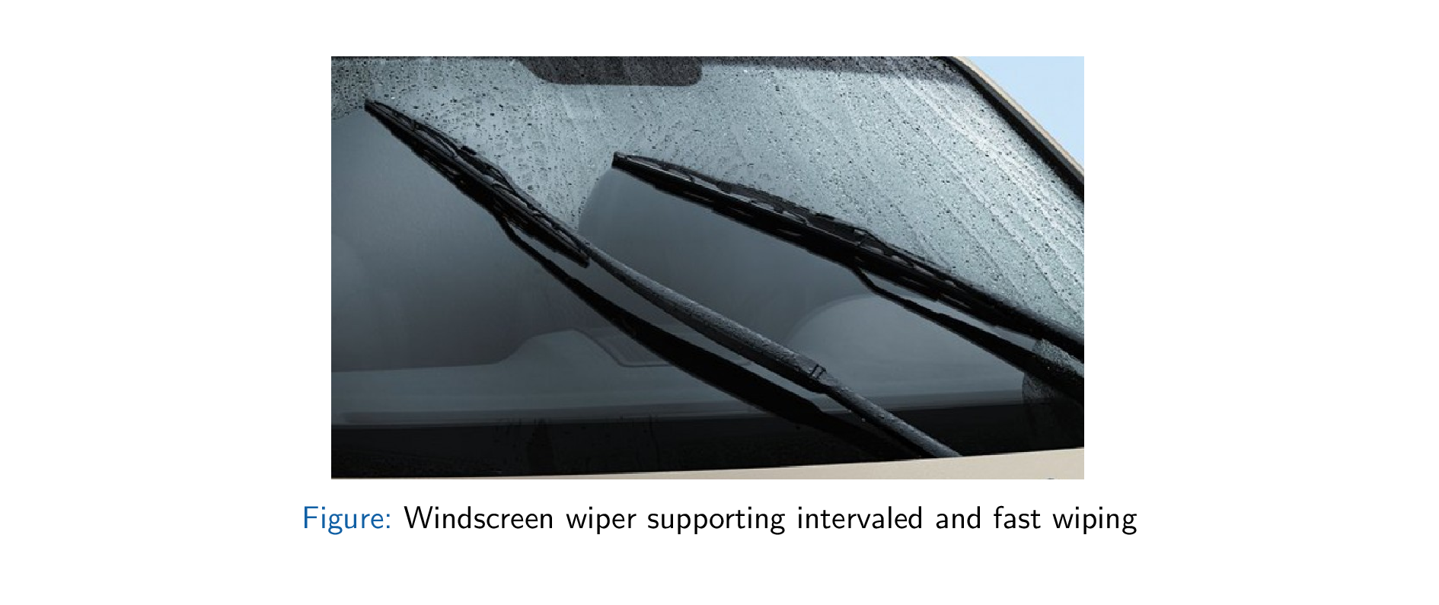
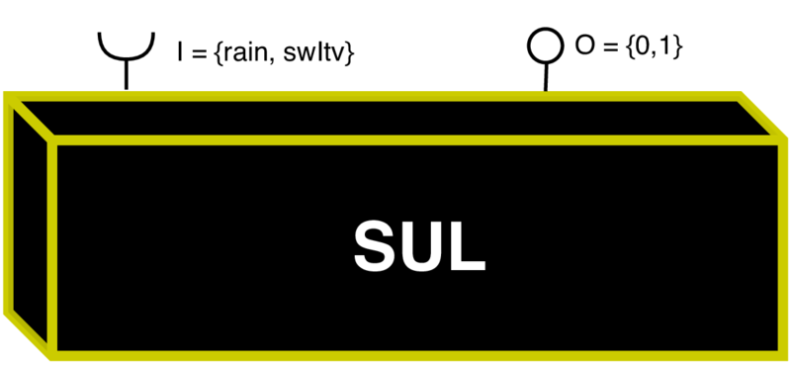
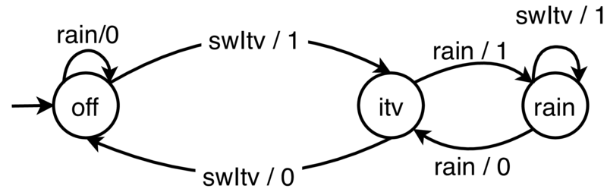
System Under Learning

Slide 16
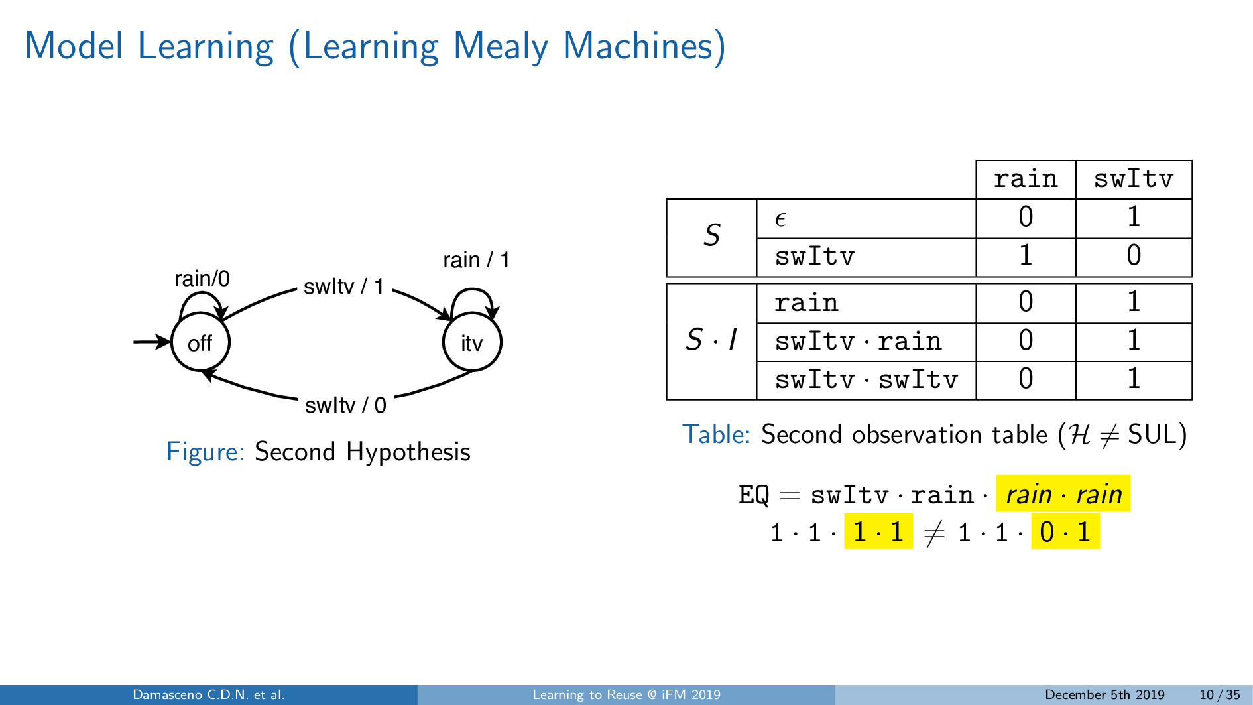
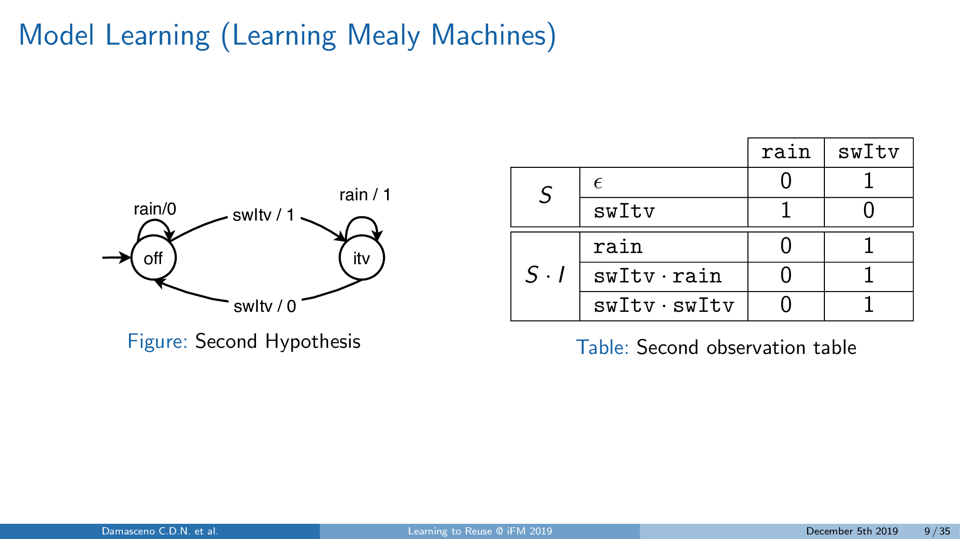
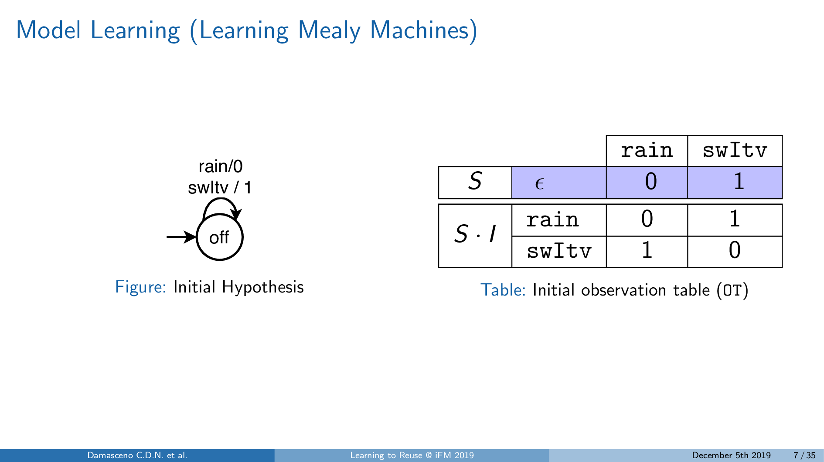
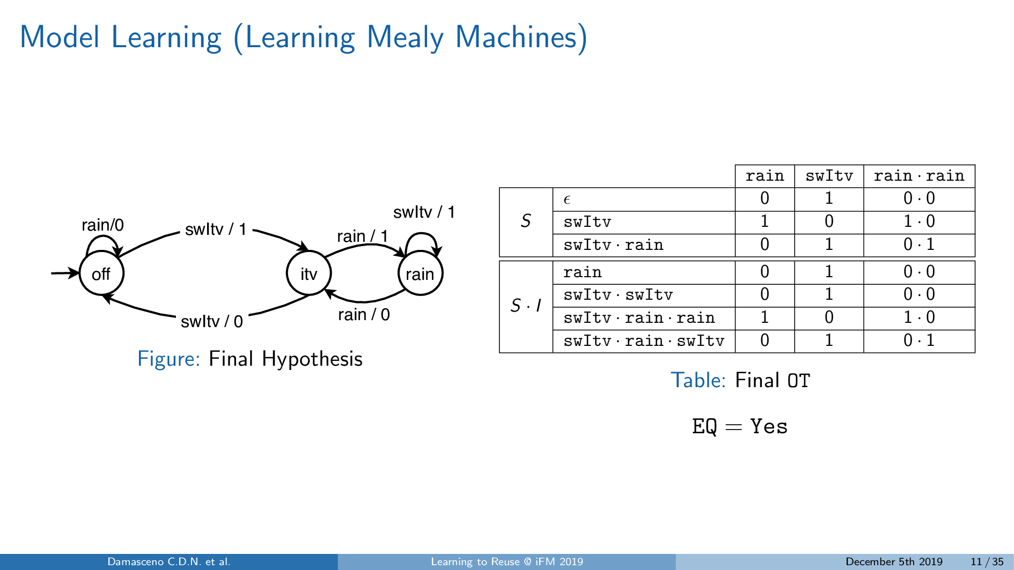
Model Learning

Slide 17
What if the SUL evolves?

Slide 18
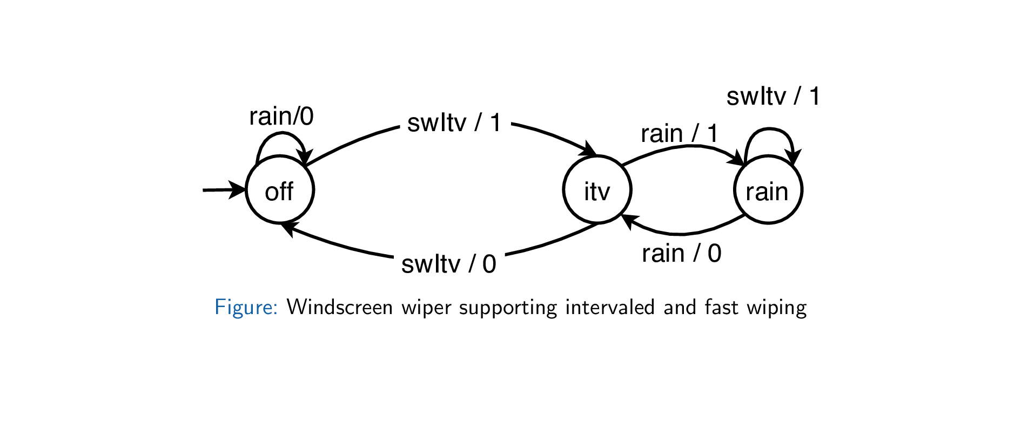
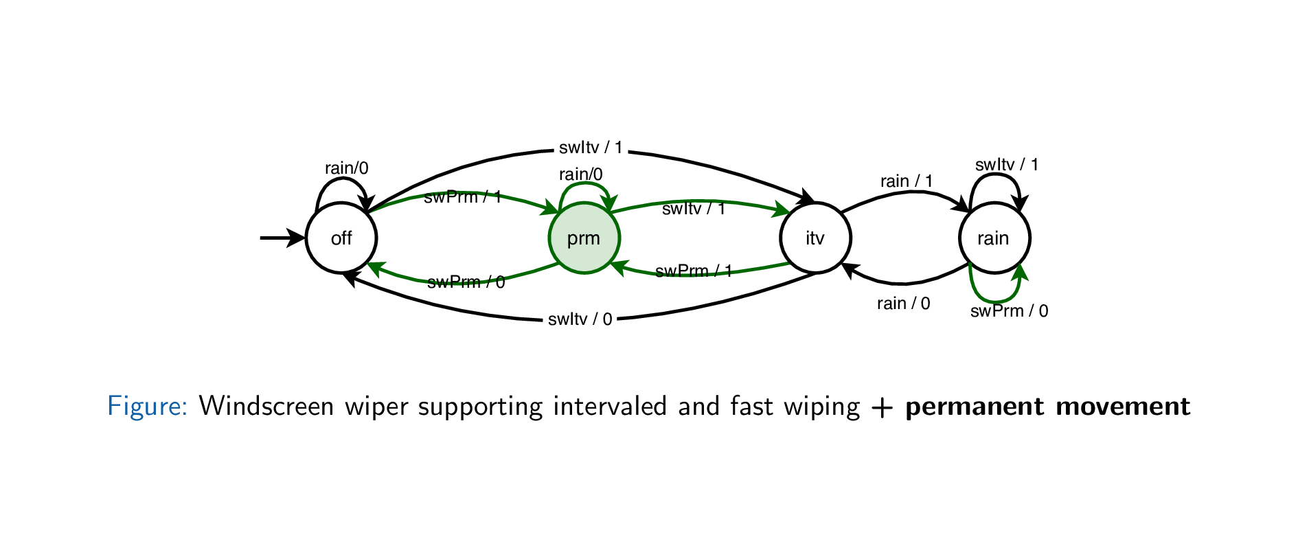
Model Learning for Evolving Systems

Slide 19

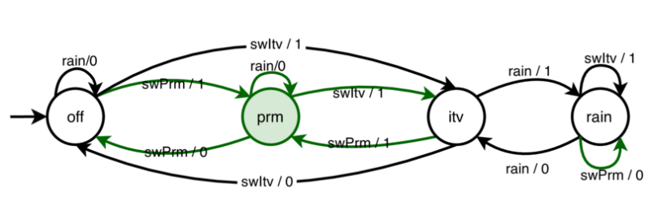

Model Learning for Evolving Systems
Minimally Adequate Teacher
Model Learning
Equivalence Queries (EQ)
Yes || Counterexample
Formulate
Membership Queries (MQ)
Version 1
Version 2
Query Output
Notes:
It turns out that traditional model learning algorithms start from scratch

Slide 20
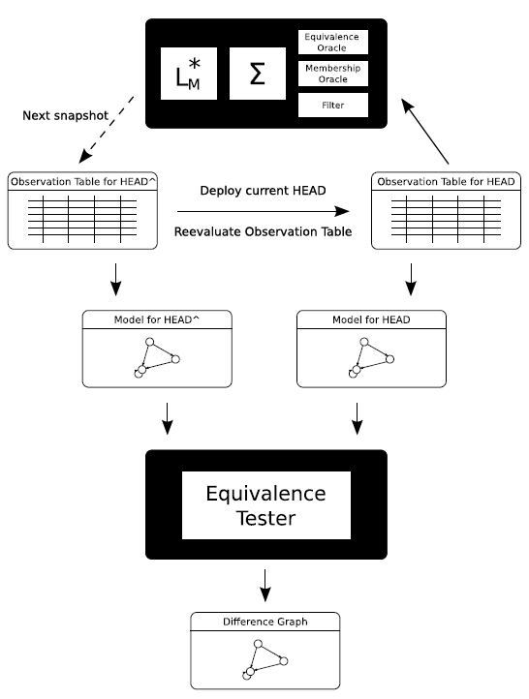
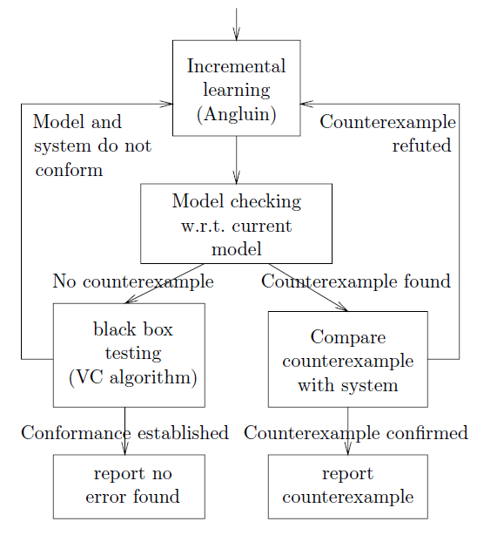

Adaptive Model Learning
What: Variant of model learning
How: Reuse transfer/separating sequences from existing models
Why: Speed up model learning
Find states maintained in newer versions
Reduce the time for model checking
Separating Sequences
RESEARCH GAPS
How can we find a subset of good-quality sequences?
Low quality sequences → Irrelevant MQs
Transfer Sequences
D. Huistra, J. Meijer, and J. van de Pol, ‘Adaptive Learning for Learn-Based Regression Testing’, in Formal Methods for Industrial Critical Systems, 2018
S. Windmüller, J. Neubauer, B. Steffen, F. Howar, and O. Bauer, ‘Active Continuous Quality Control’, in Proceedings of the CBSE 2013
A. Groce, D. Peled, and M. Yannakakis, ‘Adaptive Model Checking’, in Proceedings of the TACAS 2002

Slide 21
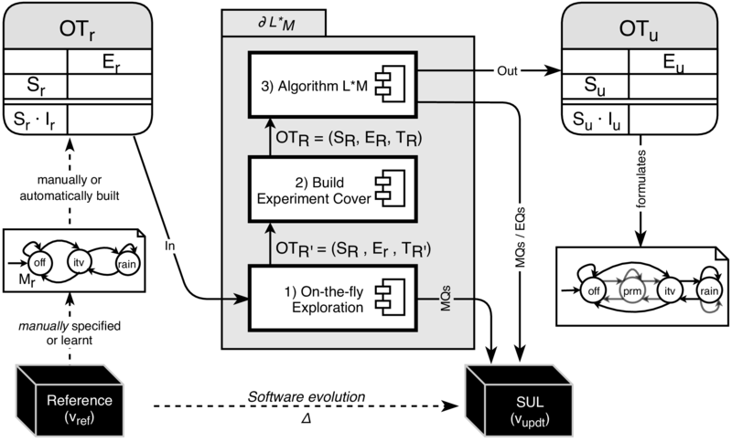
Partial-Dynamic L∗_{M} algorithm

Slide 22
1) On-the-fly exploration of the reused OT

Slide 23
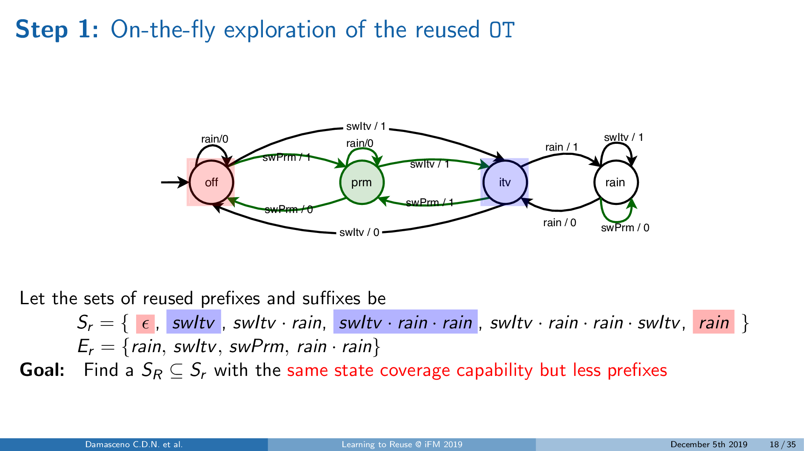
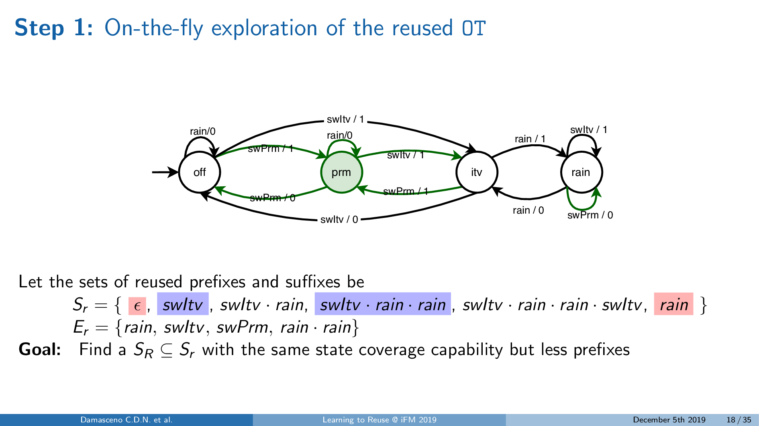
1) On-the-fly exploration of the reused OT
Notes:
Here we have an example…

Slide 24
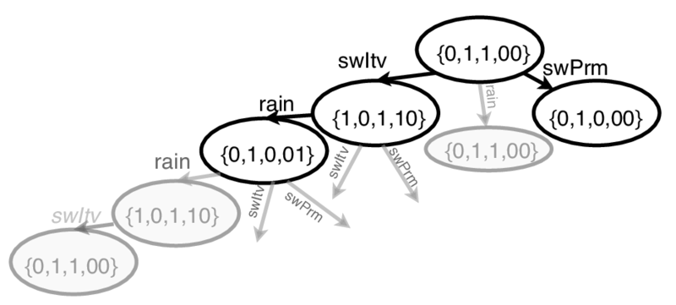
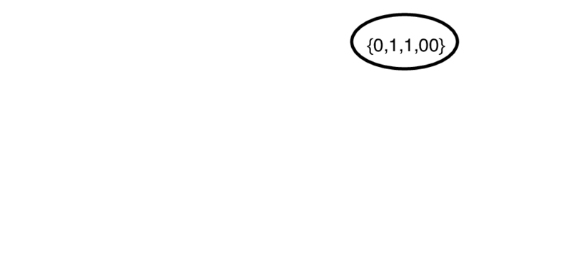
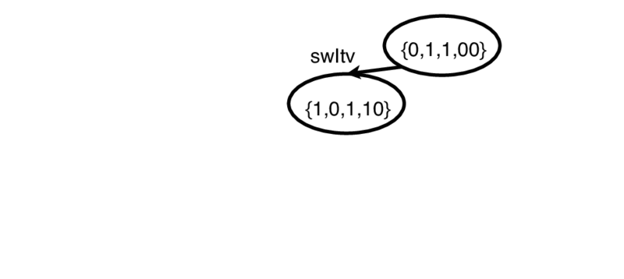
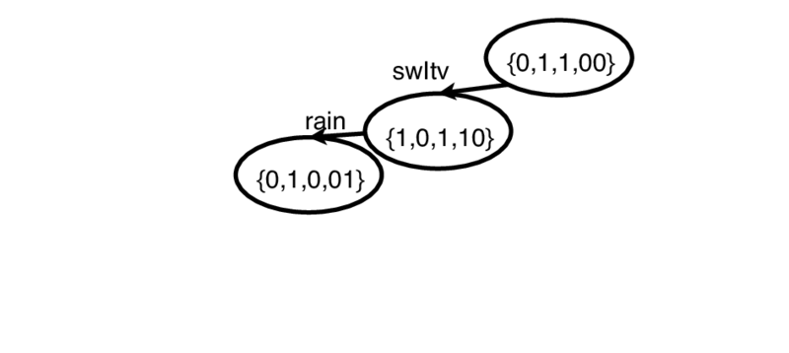
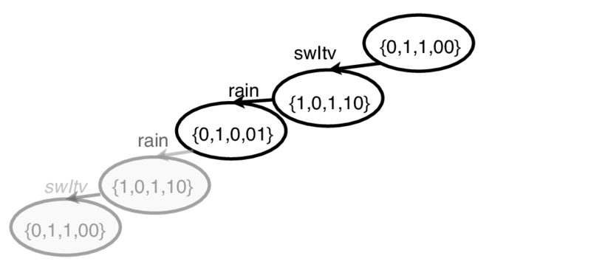
1) On-the-fly exploration of the reused OT
On-the-fly exploration of the tree representation of the set of transfer sequences
* On-the-fly: We alternate between the tree traversal steps and MQs

Slide 25
2) Build the experiment cover tree
Notes:
The partial-Dynamic L∗ M algorithm searches for deprecated separating sequences 3

Slide 26
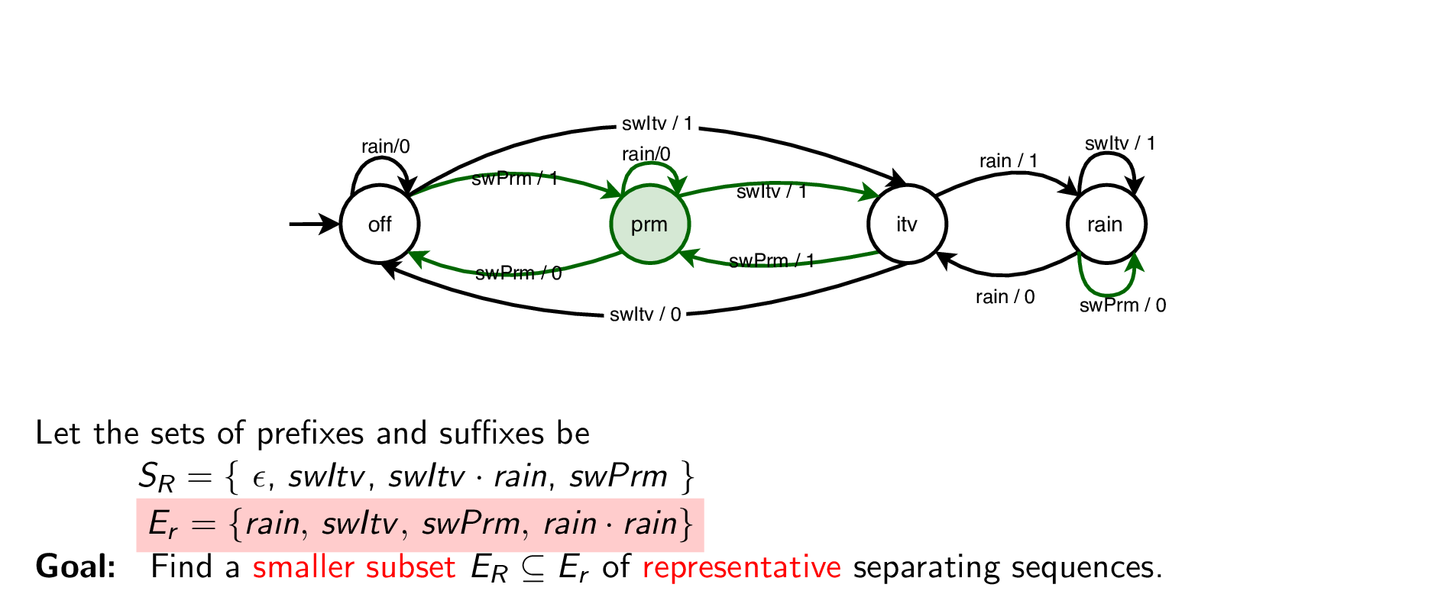
2) Build the experiment cover tree

Slide 27
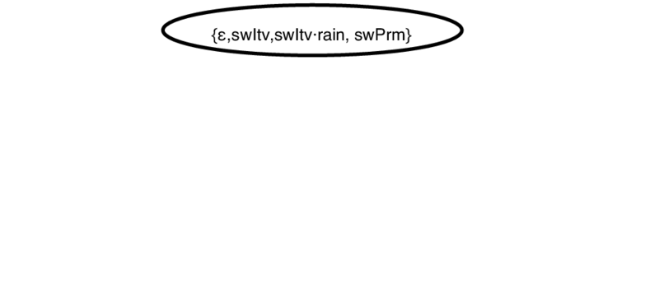
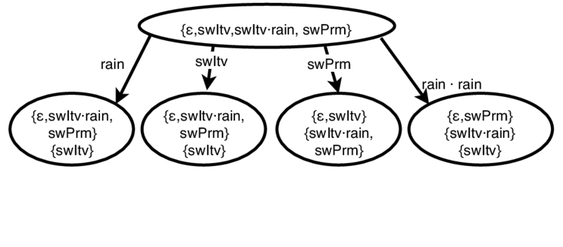
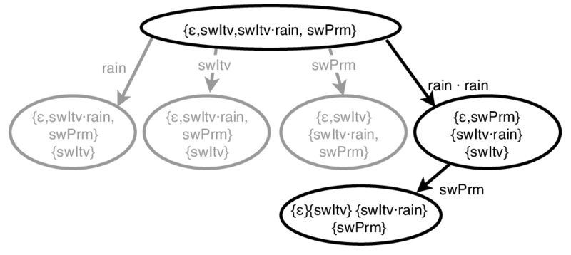
2) Build the experiment cover tree
Group transfer sequences into equivalence classes to find a smaller subset of separating sequences

Slide 28
3) Starting L∗_{M} using the outcomes of ∂L∗_{M}
Notes:
The L ∗ M algorithm starts from reused transfer and separating sequences to reach and distinguish more states than in the traditional setup (i.e., initial state only) 4 We use the subsets of reused sequences as the initial setup for model learning

Slide 29
Empirical Evaluation

Slide 30

Empirical Evaluation (Research Questions)
RQ1) Is our technique more efficient than the state-of-the-art of adaptive learning?
RQ2) Is the effectiveness of adaptive learning strongly affected by the temporal distance between versions?
D. Huistra, J. Meijer, and J. van de Pol, ‘Adaptive Learning for Learn-Based Regression Testing’, in Formal Methods for Industrial Critical Systems, 2018
S. Windmüller, J. Neubauer, B. Steffen, F. Howar, and O. Bauer, ‘Active Continuous Quality Control’, in Proceedings of the CBSE 2013
A. Groce, D. Peled, and M. Yannakakis, ‘Adaptive Model Checking’, in Proceedings of the TACAS 2002
J. de Ruiter, ‘A Tale of the OpenSSL State Machine: A Large-Scale Black-Box Analysis’, in Secure IT Systems, vol. 10014, B. B. Brumley and J. Röning, Eds. Cham: Springer, 2016,
M. Isberner, F. Howar, and B. Steffen, ‘The Open-Source LearnLib’, in CAV 2015

Slide 31
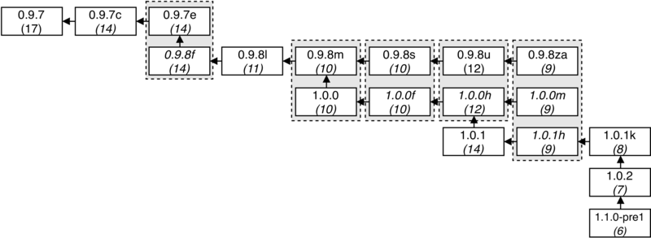
Subject Systems
Subject systems: 18 state machines describing versions of the OpenSSL toolkit
OpenSSL Foundation, Inc., ‘OpenSSL Releases at Github’, 2018. https://github.com/openssl/openssl/releases.
J. de Ruiter, ‘A Tale of the OpenSSL State Machine: A Large-Scale Black-Box Analysis’, in Secure IT Systems, vol. 10014, B. B. Brumley and J. Röning, Eds. Cham: Springer, 2016,
Notes:
We calculated the temporal distance (in years) for all pairs of versions
We learnt models for all pairs of versions and precedents (given their release dates)
We measured the numbers of MQs and EQs

Slide 32
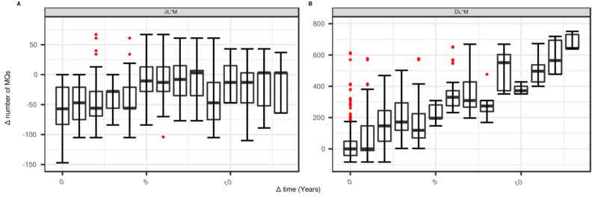
Analysis of Results (Average number of MQs)
The temporal distance between versions did not affect the performance of the ∂L∗_{M} algorithm
The ∂L∗_{M} algorithm required fewer MQs than state of the art adaptive learning algorithms
Mann-Whitney-Wilcoxon statistical test
Vargha-Delaney’s Â effect size
Pearson correlation coefficient

Slide 33


Summary (Learning to Reuse)
The state-of-the-art adaptive learning algorithms…
More sensitive to software evolution!
The ∂L∗_{M} algorithm …
Required fewer MQs than the other techniques
Temporal distance did not affect its performance

Slide 34
Research Objectives
Learning to Reuse
Learning from Differences
Learning by Sampling

Slide 35
Learning from Difference
An Automated Approach for Learning Family Models from Software Product Lines

Slide 36
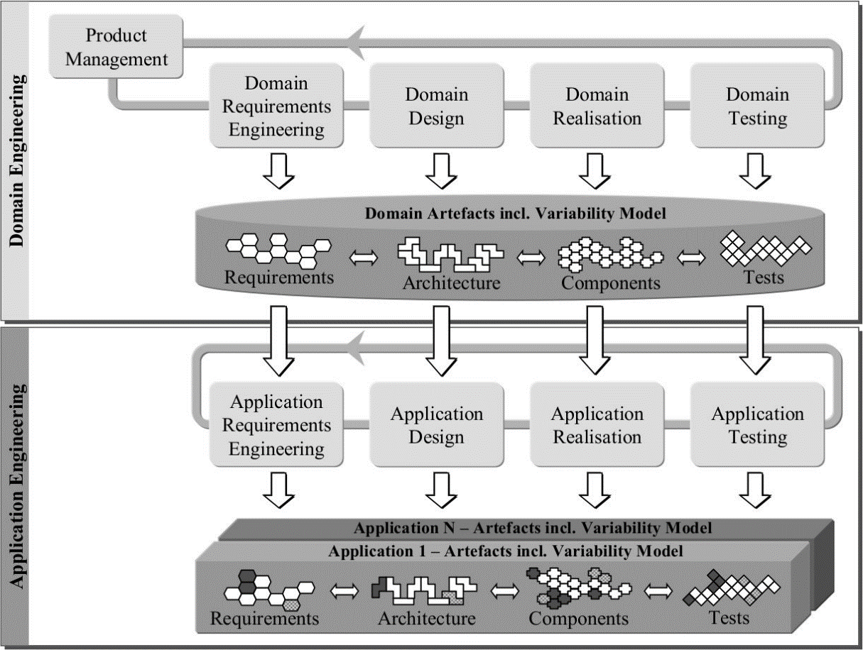

Context (Learning from Difference)
Software product lines (SPL)
Variability in space (e.g., feature model)
Common set of reusable assets
Product configurations
K. Pohl, G. Böckle, and F. J. van der Linden, Software Product Line Engineering: Foundations, Principles and Techniques. Secaucus, NJ, USA: Springer-Verlag New York, Inc., 2005.

Slide 37



Context (Learning from Difference)
Analysis and modeling of SPLs
Product-based strategies
Traditional MBT + Individual product specifications
E.g., exhaustive analysis, configuration sampling
ISSUES
Redundant analysis
Scalability (e.g., exponential)
Feature interaction problem (e.g., T-wise)
T. Thüm, S. Apel, C. Kästner, I. Schaefer, and G. Saake, ‘A Classification and Survey of Analysis Strategies for Software Product Lines’, ACM Comput. Surv., vol. 47, no. 1, p. 6:1–6:45, Jun. 2014
S. Oster, ‘Feature Model-based Software Product Line Testing’, PhD Thesis, Technische Universität, Darmstadt, 2012.

Slide 38
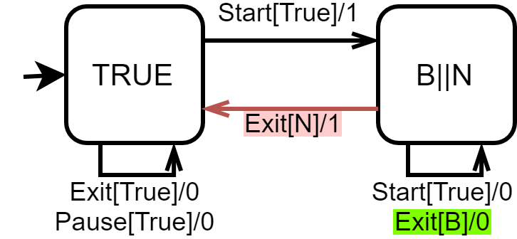
Context (Learning from Difference)
Analysis and modeling of SPLs
Family-based strategies
Corner-stone of efficient model-based SPL analysis
Family models (e.g., Featured Finite State Machine - FFSM)
ISSUES
Model maintenance and evolution
Traceability vs. Crosscutting features
Commonalities/variabilities are often unknown
T. Thüm, S. Apel, C. Kästner, I. Schaefer, and G. Saake, ‘A Classification and Survey of Analysis Strategies for Software Product Lines’, ACM Comput. Surv., vol. 47, no. 1, p. 6:1–6:45, Jun. 2014
S. Oster, ‘Feature Model-based Software Product Line Testing’, PhD Thesis, Technische Universität, Darmstadt, 2012.
V. Hafemann Fragal, A. Simao, and M. R. Mousavi, ‘Validated Test Models for Software Product Lines: Featured Finite State Machines’, in `FACS 2016.

Slide 39



Research Problem (Learning from Difference)
How can we leverage the concept of model learning to the task of behavioral variability modeling?

Slide 40
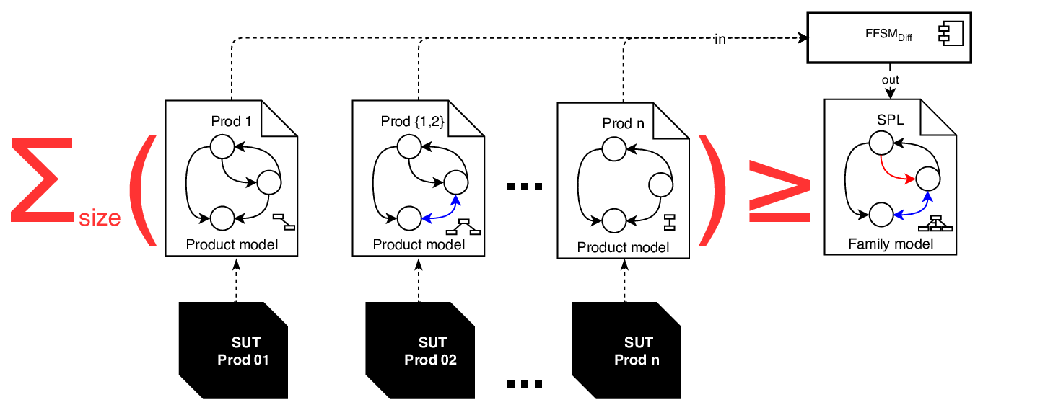


Contribution (Learning from Difference)
The FFSM Difference (FFSM _{Diff}) algorithm for learning succinct family models from individual product specifications of software product lines

Slide 41
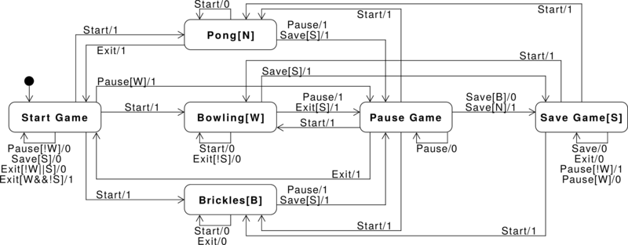
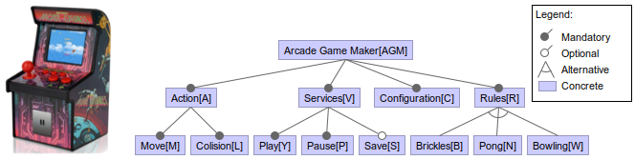
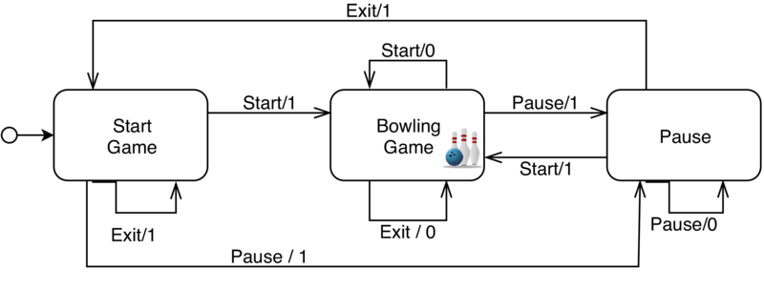
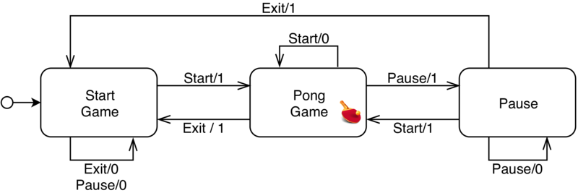
Featured Finite State Machines (FFSM)
An FFSM is a family-based representation of a product-line that unifies product-specific Mealy machines and captures the functionality of features and their interactions in terms of conditional states/transitions
V. Hafemann Fragal, A. Simao, and M. R. Mousavi, ‘Validated Test Models for Software Product Lines: Featured Finite State Machines’, in `FACS 2016.

Slide 42
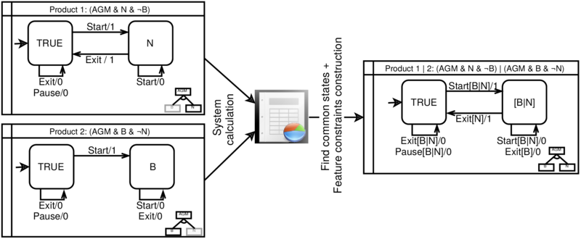
FFSM Difference (FFSM _{Diff})
The FFSM _{Diff} can learn FFSMs from a product models by employing state-based model comparison and express product-specific behaviors with feature constraints using feature model analysis
V. Hafemann Fragal, A. Simao, and M. R. Mousavi, ‘Validated Test Models for Software Product Lines: Featured Finite State Machines’, in `FACS 2016.
N. Walkinshaw and K. Bogdanov, ‘Automated Comparison of State-Based Software Models in Terms of Their Language and Structure’, ACM TOSEM, vol. 22, 2013
D. Benavides, S. Segura, and A. Ruiz-Cortés, ‘Automated analysis of feature models 20 years later: A literature review’, Information Systems, vol. 35, no. 6, pp. 615–636, 2010

Slide 43
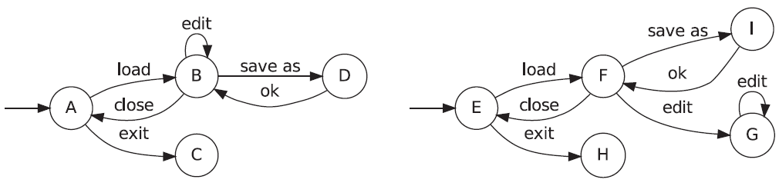



State-based model comparison (LTS _{Diff} algorithm)
Comparing the Structures of Two State Machines of a Text Editor
N. Walkinshaw and K. Bogdanov, ‘Automated Comparison of State-Based Software Models in Terms of Their Language and Structure’, ACM TOSEM, vol. 22, 2013
Notes:
State-based model comparison provides an approach to compare state-based models in terms of the actual added, removed and common states and transitions that govern the behavior.

Slide 44





State-based model comparison (LTS _{Diff} algorithm)
N. Walkinshaw and K. Bogdanov, ‘Automated Comparison of State-Based Software Models in Terms of Their Language and Structure’, ACM TOSEM, vol. 22, 2013

Slide 45

State-based model comparison (LTS _{Diff} algorithm)

Slide 46


State-based model comparison (LTS _{Diff} algorithm)
N. Walkinshaw and K. Bogdanov, ‘Automated Comparison of State-Based Software Models in Terms of Their Language and Structure’, ACM TOSEM, vol. 22, 2013

Slide 47




The FFSM _{Diff} algorithm
Our modification #2: The state mapping is used to annotate conditional states/transition
Our modification #1: The pair of initial states is assumed to be an initial landmark by definition

Slide 48


The FFSM _{Diff} algorithm
Our modification #3: We use feature model analysis to identify core features of the SPL and simplify feature constrains
V. Hafemann Fragal, A. Simao, and M. R. Mousavi, ‘Validated Test Models for Software Product Lines: Featured Finite State Machines’, in `FACS 2016.
D. Benavides, S. Segura, and A. Ruiz-Cortés, ‘Automated analysis of feature models 20 years later: A literature review’, Information Systems, vol. 35, no. 6, pp. 615–636, 2010

Slide 49
Empirical Evaluation

Slide 50
Empirical Evaluation
RQ1) Is our approach effective in learning succinct family models compared to the total size of the product pairs under learning?
RQ2) Is the size of learned family models influenced by the configuration similarity degree of the products under learning?
RQ3) Is our approach effective in learning succinct family models compared to the total size of the hand-crafted models?
C. Henard, et al., ‘Bypassing the Combinatorial Explosion: Using Similarity to Generate and Prioritize T-Wise Test Configurations for Software Product Lines’, IIEEE Trans. Software Eng., vol. 40, 2014
Notes:
Size of products → number of transitions and number of states
Configuration similarity → Hamming distance betweenproduct configurations (FeatureIDE)

Slide 51


Empirical Evaluation
M. Isberner, F. Howar, and B. Steffen, ‘The Open-Source LearnLib’, in CAV 2015
Apache, Commons Math: The Apache Commons Mathematics Library. 2016.
T. Thüm, et al., ‘FeatureIDE: An extensible framework for feature-oriented software development’, Science of Computer Programming, vol. 79, 2014

Slide 52

Subject Systems
A. Classen, ‘Modelling with FTS: a Collection of Illustrative Examples’. 2010, [Online]. Available: https://researchportal.unamur.be/en/publications/modelling-with-fts-a-collection-of-illustrative-examples
H. Samih, H. L. Guen, R. Bogusch, M. Acher, and B. Baudry, ‘Deriving Usage Model Variants for Model-Based Testing: An Industrial Case Study’, in Proceedings of the ICECCS 2014
X. Devroey, G. Perrouin, A. Legay, P.-Y. Schobbens, and P. Heymans, ‘Search-based Similarity-driven Behavioural SPL Testing’, in Proceedings of the VaMoS 2016
V. Hafemann Fragal, A. Simao, and M. R. Mousavi, ‘Validated Test Models for Software Product Lines: Featured Finite State Machines’, in `FACS 2016.
Notes:
Most of these models were originally designed as FTS
These models were made available in a “collection of examples of FTS“ that has been widely used in studies on Family-based analysis of SPLs
I transcribed them from FTSs to FFSMs
Particularly, the AEROUC5 is an example of FTS inspired by a realistic model from the avionic domain (it is an industrial situational awareness system for helicopters)

Slide 53

Analysis of Results (RQ1 – Size of Product Pairs)
Mann-Whitney-Wilcoxon statistical test
Vargha-Delaney’s Â effect size

Slide 54

Analysis of Results (RQ2 – Configuration similarity)
Pearson correlation coefficient
Notes:
In red, we have the original size of the hand-crafted FFSMs

Slide 55
Analysis of Results (RQ3 – Size of Handcrafted models)
Mann-Whitney-Wilcoxon statistical test
Vargha-Delaney’s Â effect size
Notes:
In red, we have the original size of the hand-crafted FFSMs

Slide 56

Analysis of Results (RQ3 – Size of Handcrafted models)
Notes:
In red, we have the original size of the hand-crafted FFSMs

Slide 57

Analysis of Results (RQ3 – Size of Handcrafted models)
V. H. Fragal, ‘Automatic generation of configurable test-suites for software product lines’, PhD Thesis, Universidade de São Paulo, 2017.
Notes:
In red, we have the original size of the hand-crafted FFSMs

Slide 58
Summary (Learning from Difference)
The FFSM _{Diff} algorithm is able to…
Learn fresh FFSMs from products pairs
Especially if there is high feature reuse (i.e., configuration similarity)
Incorporate new product behavior into an existing FFSM
Family model recovery (e.g., reverse engineering, re-engineering)

Slide 59
Research Objectives
Learning to Reuse
Learning from Differences
Learning by Sampling

Slide 60
Learning by Sampling
Learning Behavioral Family Models from Software Product Lines

Slide 61




Context (Learning by Sampling)
Software product lines (SPL)
Product-based strategies: Impractical?
Family-based strategies: Models?
Family model learning → FFSM _{Diff}
Exhaustive learning
Learning by Sampling

Slide 62


Research Problem (Learning by Sampling)
How can we optimize family model learning to make it more effective?

Slide 63


Contribution (Learning by Sampling)
M. Isberner, F. Howar, and B. Steffen, ‘The Open-Source LearnLib’, in CAV 2015
Apache, Commons Math: The Apache Commons Mathematics Library. 2016.
T. Thüm, et al., ‘FeatureIDE: An extensible framework for feature-oriented software development’, Science of Computer Programming, vol. 79, 2014

Slide 64
Empirical Evaluation

Slide 65
Empirical Evaluation
RQ4) Is our approach effective in learning precise family models by sampling compared to exhaustive learning?

Slide 66

Subject Systems
A. Classen, ‘Modelling with FTS: a Collection of Illustrative Examples’. 2010, [Online]. Available: https://researchportal.unamur.be/en/publications/modelling-with-fts-a-collection-of-illustrative-examples
H. Samih, H. L. Guen, R. Bogusch, M. Acher, and B. Baudry, ‘Deriving Usage Model Variants for Model-Based Testing: An Industrial Case Study’, in Proceedings of the ICECCS 2014
X. Devroey, G. Perrouin, A. Legay, P.-Y. Schobbens, and P. Heymans, ‘Search-based Similarity-driven Behavioural SPL Testing’, in Proceedings of the VaMoS 2016
V. Hafemann Fragal, A. Simao, and M. R. Mousavi, ‘Validated Test Models for Software Product Lines: Featured Finite State Machines’, in `FACS 2016.
Notes:
Most of these models were originally designed as FTS
These models were made available in a “collection of examples of FTS“ that has been widely used in studies on Family-based analysis of SPLs
I transcribed them from FTSs to FFSMs
Particularly, the AEROUC5 is an example of FTS inspired by a realistic model from the avionic domain (it is an industrial situational awareness system for helicopters)

Slide 67

Analysis of Results (RQ4 – Learning by Sampling)
More precise family models
Higher values of T
Mann-Whitney-Wilcoxon statistical test
Vargha-Delaney’s Â effect size

Slide 68
Summary (Learning by Sampling)
Learning by sampling can lead to family models as precise as those obtained by exhaustive analysis
Higher interaction strengths lead to higher coverage
We show evidences that product sampling can be helpful to family model learning and recovery

Slide 69
Final Remarks and Future Work

Slide 70
Contributions of this PhD Thesis
Learning to Reuse
Learning from Differences
Learning by Sampling
C. D. N. Damasceno, M. R. Mousavi, and A. Simao, ‘Learning to reuse: Adaptive model learning for evolving systems’, in 15th Integrated Formal Methods, Bergen, Norway, 2019
C. D. N. Damasceno, M. R. Mousavi, and A. Simao, ‘Learning from Difference: An Automated Approach for Learning Family Models from Software Product Lines’, in 23rd International Systems and Software Product Line Conference, 2019
C. D. N. Damasceno, M. R. Mousavi, and A. Simao, ‘Learning by sampling: Evaluating t-wise sampling for learning family models’. Empirical Software Engineering (Submitted and under review), 2020.

Slide 71






The main publications of this PhD Thesis

Slide 72








Other contributions

Slide 73


Future Work
Adaptive Learning for Discrimination Tree-Based Methods
Learning to Reuse
Active family model learning
Incremental Configurable Queries
Fingerprinting evolving systems
Learning from Differences
Learning by Sampling
M. Isberner, F. Howar, and B. Steffen, ‘The TTT Algorithm: A Redundancy-Free Approach to Active Automata Learning’, in Runtime Verification, 2014
C. D. N. Damasceno, ‘Learning From Families: Inferring Behavioral Variability From Software Product Lines’, presented at the PhD Symposium at Integrated Formal Methods, Bergen, Norway, 2019.
M. Al-Hajjaji, S. Krieter, T. Thüm, M. Lochau, and G. Saake, ‘IncLing: Efficient Product-Line Testing Using Incremental Pairwise Sampling’, in Proceedings of the GPCE 2016
G. Shu and D. Lee, ‘Network Protocol System Fingerprinting - A Formal Approach’, in Proceedings of the IEEE INFOCOM 2006

Slide 74




Thank you
Questions?

